Slide 1
A/B Testing Fundamentals
Aleksei Shashkov
Special for GNT-ARAI-8

Slide 2

About me
Notes:
Graduated from a Technical University — Automated Control Systems
Research and scientific work - PhD & Medical Decision Support Systems, based on Expert systems, Cluster analysis, Fuzzy logic & Genetic algorithms
Developed my own “Evolutionary classification method” to solve the classification problem based on the use of genetic algorithms mechanisms and cluster analysis, I have a copyright certificate (©) for the development of this algorithm
Taught a bit statistics and modeling at the university
Data Analytics course

Slide 3
Education and research
🎓 Graduated from a Technical University — Automated Control Systems
🔬 Research and scientific work - PhD & Medical Decision Support Systems, based on Expert systems, Cluster analysis, Fuzzy logic & Genetic algorithms
💡Developed my own “Evolutionary classification method” based on the using of genetic algorithms mechanisms and cluster analysis (classification task)
👨‍ Taught a bit statistics and modeling at the university 🎓 MINI-MBA Professional (Management)
📊 Data Analytics course (2023)
Notes:
Graduated from a Technical University — Automated Control Systems
Research and scientific work - PhD & Medical Decision Support Systems, based on Expert systems, Cluster analysis, Fuzzy logic & Genetic algorithms
Developed my own “Evolutionary classification method” to solve the classification problem based on the use of genetic algorithms mechanisms and cluster analysis, I have a copyright certificate (©) for the development of this algorithm
Taught a bit statistics and modeling at the university
Data Analytics course

Slide 4
Professional activity
At school 🐥 Worker – produced chicken feed at age 15
🎒 Camp counselor in a children’s camp
In the university
📦 Loader
✏ Private tutor
Postgraduate
🔬 Scientific research in medicine & IT (3 years)
Career
👨‍💻 Head of IT departments (17 years)
📋🔍 Internal auditor (5 years)
Notes:
I started working at the age of 15 producing chicken feed, because I wanted to buy tape recoder. Later, I worked as a camp counselor in a children’s summer camp. As a student, I took part-time jobs as a loader and a private tutor. After graduating from university, I conducted scientific research at the intersection of medicine and IT and taught at the university. Later, I moved to Siberia and worked in oil companies for more than 22 years: 17 years as the head of IT departments and the last 5 years as an internal auditor.

Slide 5

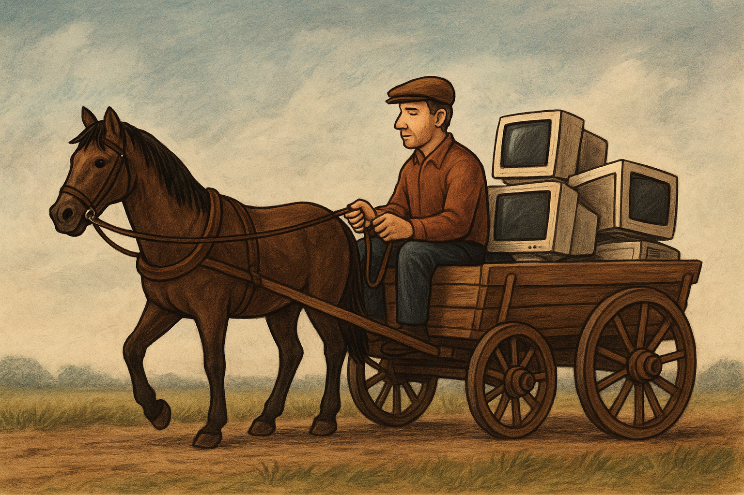
Interesting facts
🔥 Born during the fire ⬄ moved to ❄ Siberia with –50°C winters
❤ Afraid of relationships, virgin until 28 ⬄ now I have 2 wives
(1 - ex) and 4 children. Youngest son (👶) is 4 months
🌍 Lived in rural Russia ⬄ now in the center of Europe
🎓 Graduated with an IT degree ⬄ didn’t have my own computer. First computers were delivered by horse
Notes:
I was born during the fire but later moved to Siberia, where winter temperatures can reach –50°C. I was afraid of relationships and remained a virgin until 28, but now I have had two wives (one ex-wife) and four children — my youngest son is 4 month. I graduated with an IT degree, but I didn’t own a computer at that time. In fact, the first computers at my university were literally delivered by horse. I did scientific research, but now I can barely understand what exactly I invented back then. I graduated from an aviation university and studied aircraft systems in detail, but I only took my first passenger flight several years later.

Slide 6
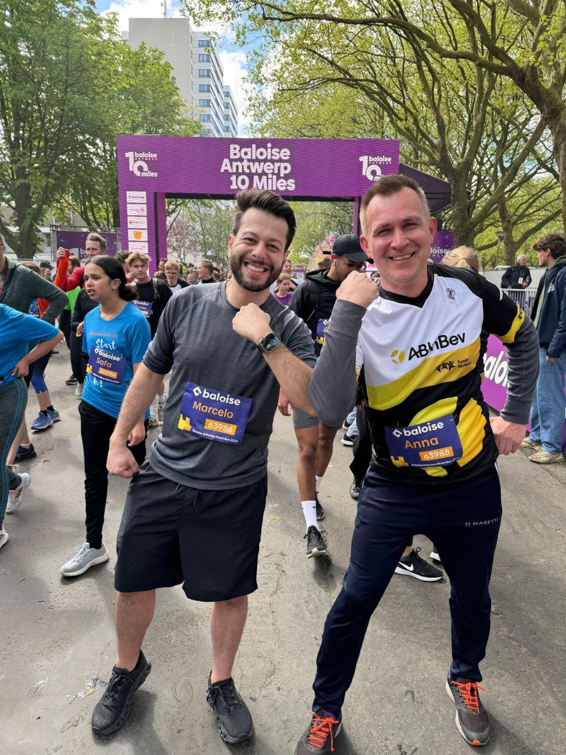

SPORTS & COMPETITIONS
Participated in 20+ sports competitions:
⚽ football
🏐 volleyball 🏀 basketball ♟ chess
🏊 swimming
🏒 hockey
🎯 darts
🏏 Lapta
Kubb — “Viking chess”
🏃‍ 10 Miles in Antwerp Always compete with no training.
Notes:
I was never a professional athlete in any sport, but I participated in competitions in more than 20 different sports, including lapta, floorball, disc-ball, felt-boot hockey, and kubb — the “Viking chess.” I even have a photo with a trophy from the Antwerp Run. I always participate in competitions with no preparation or training.

Slide 7



HOBBIES
Music school (balalaika), 🎤 Sang in a choir, 🎸 play guitar
💆 Completed massage courses
✈ Travel & Adventure (visited ~35 countries)
Hiking and trekking
🌄 Mountain climbing
🌊 Rafting
📚 Reading
Intellectual games: I helped organize the first Russian-speaking quiz in Brussels
Alcohol consumption:
student
freedom
family man
Notes:
I graduated from a music school with a balalaika major, sang in a choir, did track and field, and completed massage therapy courses. I love traveling and have visited about 35 countries. I enjoy hiking, climbing mountains, rafting, playing guitar, reading, and intellectual games. I helped friends organize the first Russian-speaking quiz in Brussels. There is a stereotype that Russians drink a lot. Yesterday I found some statistics and the rate in Belgium is practically the same. As for me…

Slide 8
A/B Testing Fundamentals
Notes:
Today we are going to talk about A/B testing — one of the core tools in data analytics and data-driven decision making. Almost every digital product today — websites, mobile apps, marketing campaigns — can and should be evaluated using experiments.
The key idea is simple: instead of guessing what works better, we measure it using data. This is an important topic that comes up in interviews, especially if you are applying for a product analyst position.
Let’s walk through an example. Imagine that you are a data analyst at a real estate agency called Emma-Eliza. The company’s goal is to increase the conversion rate of website visitors into requests for property viewings.
Suppose a designer suggests changing the visual design of the website. For example, the current design relies heavily on red colors, and the designer believes this is too aggressive. He proposes switching to a calmer color palette — such as blue, green, or beige — and claim that this change will make users more likely to submit a viewing request when they visit the site.
Your task is to test this hypothesis. And this is exactly where A/B testing becomes necessary — but only if the experiment is designed and calculated correctly.
What is the wrong approach? The wrong way would be to change the design for all users at once, run the experiment for a fixed period and then evaluate the results.
If someone suggests this approach, you, as a data analyst, should immediately challenge it.
Let’s say we introduce the new design on January 1st. By mid-January, we observe that our key metric — the number of viewing requests — has increased and we might be tempted to say: “Great, the blue color works better.”
However, in reality, this conclusion may be completely incorrect.
The increase in the metric might have nothing to do with the design change at all. Starting from January 1st, many other factors could have changed:
more people may have gone on vacation,
new regulations in Belgium might have been introduced,
or some other part of the service may have changed — for example, the user navigation flow on the website.
In other words, many things could have changed at the same time, including factors you may not even be aware of. Therefore, claiming that the metric increased specifically because of the color change would be incorrect and misleading.

Slide 9
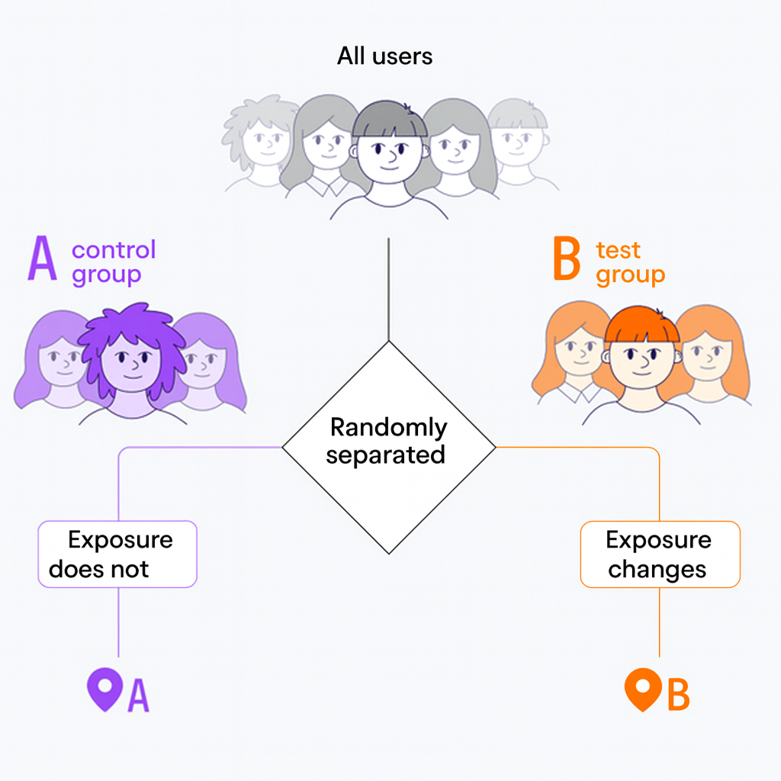
What Is A/B Testing?
A – Control group - The group on which the old intervention A remains.
B – Test group – the group on which the new intervention B is tested
Notes:
What should we do instead? We need to split our users into two or more groups: one group continues to see the old version — in our case, the red design. Another group is exposed to the new version — the updated design.
The key point is that both groups exist in the same reality at the same time. Any external changes affect both groups equally and we can reasonably attribute this difference to the design change.

Slide 10
What Is A/B Testing?
Definition
A method of experimental comparison of two versions of a product (A and B) to determine which one has a better impact on the target metric.
Used for
increasing conversion rates
changing user behavior
hypothesis testing
optimizing business metrics
Key principle: test only one change at a time.
Notes:
A/B testing is an experimental method used to compare two versions of the same product or feature. Version A is the control — the current version. Version B is the test — a new version with a change.
Users are randomly split into two groups, and each group sees only one version. Then we compare how these groups behave and measure the impact on a specific metric.
The most important part is that A/B testing allows us to measure causal impact, not just correlation.

Slide 11
Why Businesses Use A/B Testing
Reducing customer acquisition cost
Increasing revenue
Lowering the risk of poor decisions
Improving funnel conversion
Testing product ideas without large investments
Notes:
Businesses use A/B testing to make better decisions with lower risk. Instead of rolling out changes to all users, companies test them on a smaller group first.
A/B testing helps increase conversion rates, improve revenue, and reduce customer acquisition costs. Most importantly, it allows teams to validate product and marketing ideas before scaling them.

Slide 12
Examples of Changes for an A/B Test
button size or color
banner text
a new landing page
simplifying the registration form
a new recommendation algorithm
price or discount changes
Notes:
In practice, almost anything can be tested. This includes button text or color, landing page layouts, registration forms, recommendation logic, and even pricing.
However, there is one strict rule: in a single A/B test, we change only one factor. If we change multiple things at the same time, we won’t know what actually caused the result.

Slide 13
Key Concepts of A/B Testing
Control (A) — the current version
Test (B) — the new version
Metric — what we measure (conversion, CTR, ARPU, etc.)
Null hypothesis (H₀) — “there is no difference”
Alternative hypothesis (H₁) — “the test performs better than the control”
Statistical significance
Test power
MDE (Minimum Detectable Effect)
Notes:
To understand A/B testing, we need a few key concepts.
We always have a control group and a test group, and we measure a specific metric — for example, conversion or Click-Through Rate. We also define statistical hypotheses: the null hypothesis says there is no difference, and the alternative hypothesis says the test performs better.
Other important concepts are statistical significance, test power, and MDE — the minimum detectable effect.

Slide 14
The A/B Testing Cycle
Formulating a hypothesis
Choosing a metric
Calculating sample size
Randomization and test launch
Data collection
Results analysis
Decision making
Notes:
A/B testing follows a clear and structured process.
We start by formulating a hypothesis, then choose the metric and calculate the required sample size. After that, we randomize users, run the test, collect data, analyze the results, and finally make a decision.
Skipping any of these steps usually leads to unreliable results.

Slide 15
Theory: What Is Statistical Significance?
We check the following question: Could the observed difference have occurred by chance?
If p-value < 0.05 → unlikely → we consider the difference statistically significant.
Notes:
When we analyze results, we ask a simple question: could the observed difference have happened by chance?
The p-value helps us answer this question. If the p-value is below 0.05, we usually consider the result statistically significant.
It is important to remember that statistical significance does not measure business value — it only measures statistical confidence.

Slide 16
Theory: Test Power
Power is the probability of detecting a real effect if it truly exists.
Typically, power is set to 80%.
If power is low, the test is effectively “blind” and may fail to detect improvements
Notes:
Even if a real effect exists, a test might fail to detect it. That’s why test power is important.
Power is the probability of detecting a real effect if it truly exists, and it is usually set to 80%.

Slide 17
Theory: MDE (Minimum Detectable Effect)
MDE is the smallest change that the test can reliably detect.
If MDE = 2 percentage points, the test can detect a difference between 10% and 12%.
Large MDE → smaller required sample size (but lower sensitivity)
Small MDE → sample size increases significantly
Notes:
MDE defines how small an effect the test can detect.
There is always a trade-off: smaller MDE means higher sensitivity, but it also requires a larger sample size.

Slide 18
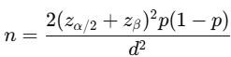
Sample Size Calculation
Formula for conversion metrics:
Parameters:
p — baseline conversion rate
d — MDE
Notes:
Here I just want to say that there is a formula with which you can calculate the sample size and which depends on such parameters as baseline conversion rate, MDE

Slide 19
Sample Size Calculation Example
Baseline conversion: 10%
Expected uplift: 2 percentage points
MDE = 0.02
Power = 80%, alpha = 5%
➜ Approximately 8,000 users per group are required.

Slide 20
Randomization
Proper user assignment to groups must be:
random
balanced
independent
non-discriminatory
non-overlapping.
Notes:
Users must be assigned to groups randomly and evenly. Each user should belong to only one group and stay there for the entire test.
Poor randomization leads to biased results and can completely invalidate the experiment.

Slide 21
Analysis: Hypothesis Testing
For binary metrics, the following methods are commonly used:
z-test for proportions
t-test (approximation)
chi-square test
bootstrap
Notes:
After the test is complete, we compare the metrics between the control and test groups.
For binary metrics, we often use z-tests, t-tests, chi-square tests, or bootstrap methods. In addition to p-values, we should always look at effect size and confidence intervals to understand the stability of the result.

Slide 22
User Assignment with Hashing
A hash function is a function that converts an arbitrary input array into a string of a specific type and length.
Hashing is the transformation of any amount of information into a unique set of characters that is unique to that input array.
Let's consider the Python crc32 function.
Hashing is applied to unique identifiers (IDs) to ensure that:
The partitioning is random.
Each unit belongs to only one group
Notes:
In real-world A/B testing, we rarely assign users to groups using a simple random function on every request.
Instead, we usually rely on hashing. We take a stable user identifier — such as a user ID, device ID — and pass it through a hash function.
The hash value is then mapped to a specific experiment group. This approach ensures that the same user is always assigned to the same group, even across multiple sessions.
Hashing provides a deterministic and reproducible way to split users, which is critical for experiment validity.

Slide 23
Experiment Salt
An experiment's salt is a string of characters that is appended to the client's ID before hashing to ensure random assignment within each new experiment. Without salt, the same client will be assigned to the same group in any experiment (depending on their ID).
Partitioning with salt: each client will be randomly assigned to a new group in each new experiment.
Notes:
To control user assignment across different experiments, we use something called an experiment salt. A salt is an experiment-specific value that is combined with the user ID before hashing. For example, we might hash user_id + experiment_name. This allows the same user to be assigned differently in different experiments, while remaining stable within a single experiment. Using a salt helps us:
keep experiments independent,
avoid unintended correlations between tests
safely re-randomize users for new experiments.
In practice, hashing with a salt is the standard approach used in large-scale experimentation systems.

Slide 24
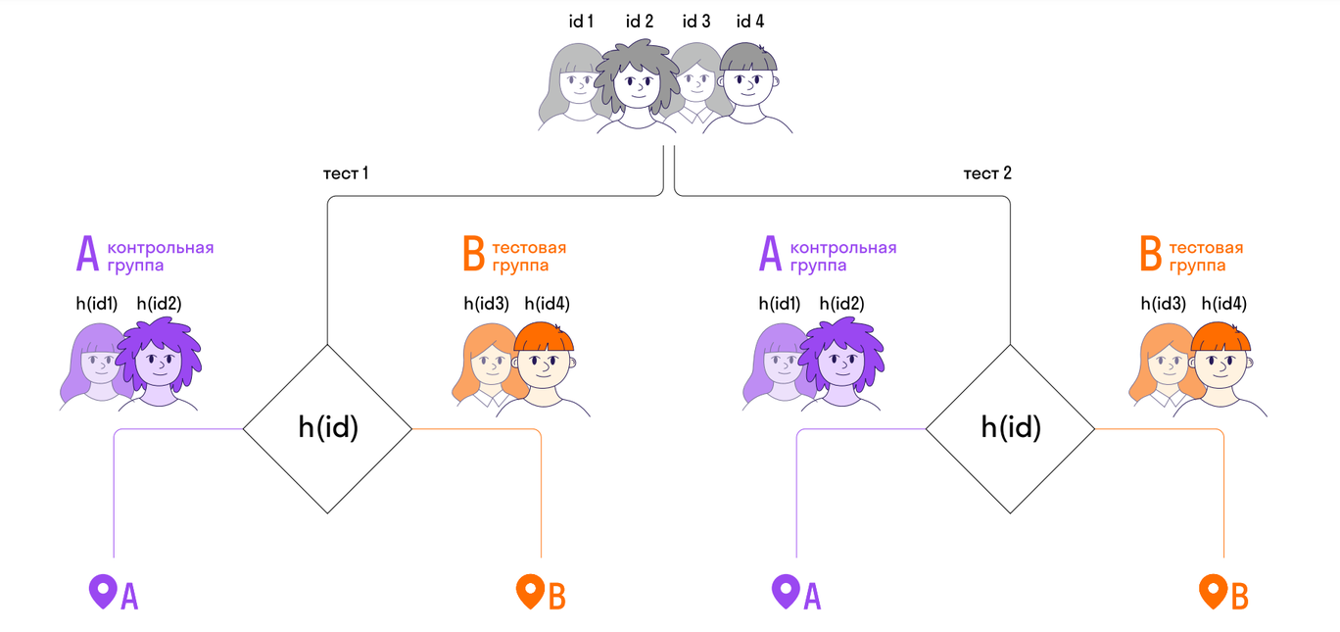
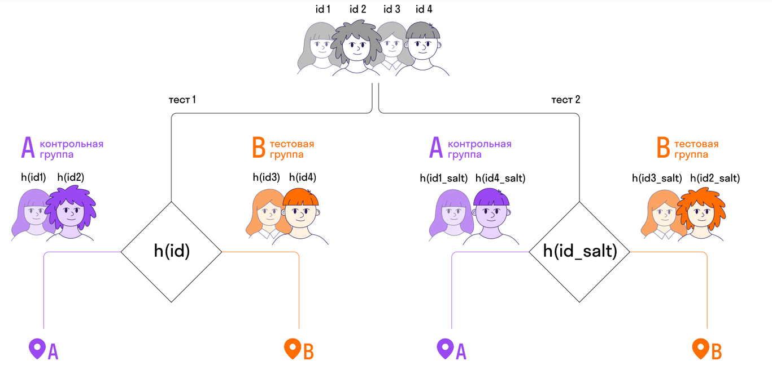
Experiment Salt
test 1
test 2
control group
test group
control group
test group
test 1
test 2
control group
test group
control group
test group

Slide 25
Common Mistakes
stopping the test too early
multiple hypothesis testing (multiplicity)
poor randomization
incorrect metric selection
test duration is too short
testing on the wrong user segment
Notes:
Many A/B tests fail not because of statistics, but because of process mistakes.
Common issues include stopping tests too early, testing multiple hypotheses at once, choosing the wrong metric, or running tests for too short a time.
Discipline and patience are critical for reliable A/B testing.

Slide 26
Key Takeaways
A/B testing enables objective, data-driven decision making.
It:
minimizes risk
reveals real effects
scales well
supports a Data-Driven approach
Notes:
A/B testing is a foundational tool for data-driven decision making.
It helps teams measure causal impact, reduce risk, and scale improvements with confidence. When designed correctly, A/B testing becomes one of the most powerful tools in a data analyst’s toolkit.

Slide 27
Thank you!

Slide 28
Python_Sample
Task. You work at the real estate agency Immo-Eliza. The company sends an SMS about new properties in their city to all users registered in the application.
It was decided to conduct an A/B test (in 5 big cities), where the test group would receive an email with the same content instead of an SMS
It is necessary to analyze the results of the A/B test.
📊 Table Description:
Column Name | Description
id_client | Unique client identifier
id_group | Group identifier (0 — control, 1 — test)
city | City name
nflag_purchase | Purchase fact (1 — advertised product was purchased, 0 — no)
time_came | User registration date in the application

Slide 29
Python: Sample Size Calculation
from statsmodels.stats.power import NormalIndPower
from statsmodels.stats.proportion import proportion_effectsize
baseline = 0.10
target = 0.12
effect_size = proportion_effectsize(baseline, target)
analysis = NormalIndPower()
sample_size = analysis.solve_power(
effect_size=effect_size,
power=0.8,
alpha=0.05,
ratio=1
)
print("Sample size per group:", round(sample_size))

Slide 30
Visualization: Conversion Distribution
import numpy as np
import matplotlib.pyplot as plt
control = np.random.binomial(1, 0.10, 10000)
test = np.random.binomial(1, 0.12, 10000)
plt.hist([control, test], bins=2, label=["Control", "Test"])
plt.legend()
plt.title("Conversion Distribution")
plt.show()

Slide 31
Python: Simple Group Comparison
import numpy as np
from scipy import stats
control = np.random.binomial(1, 0.10, 1000)
test = np.random.binomial(1, 0.12, 1000)
z, p = stats.ttest_ind(control, test)
print("p-value =", p)

Slide 32
Учеба и наука
Закончил технический университет в России (автоматизированные системы управления). Занимался наукой, преподавал в университете, в том числе статистику и моделирование, защитил диссертацию связанную с системами поддержки принятия решений в медицине на основе таких методов, как экспертные системы, кластерный анализ, нечеткая логика, генетические алгоритмы, автор нового своего собственного метода эволюционной классификацим, решение задачи классификации на основе использования механизмов генетических алгоритмов и кластерного/дискриминантного анализа, имею авторское свидетельство на разработку этого алгоритма
В 2023 закончил 9-месячный курс Data Analytics
Профессиональная деятельность
Начал работать в 15 лет – производил корм для куриц. Потом работал вожатым в детском лагере, студентом подрабатывал грузчиком и репетиторством, после окончания университета занимался научными исследованиями на стыке медицины и ИТ, преподавал, а затем уехал в Сибирь и более 22 лет проработал в нефтяных компаниях: 17 лет - руководителем ИТ-отделов и последние 5 лет - внутренним аудитором.

Slide 33
Интересные факты
Родился в пожар, но переехал жить в Сибирь, где морозы бывают до -50.
Боялся отношений с девушками, до 28 был девственником, но сейчас 2 жены (1 - ex) и 4 детей, последний родился, когда мне было 50
Я закончил универнситет по ИТ-специальности, но у меня не было своего компьютера. И вообще первый компьютеры, привезли на лошади.
Занимался наукой, а сейчас с трудом разбираюсь с тем, что же я тогда напридумывал.
Закончил авиационный университет, детально изучал системы летательных аппаратов, но первый полет в качестве пассажира совершил только через несколько лет.
Я не был профессиональным спортсменом ни в одном из видов спорта, но принимал участие в соревнованиях по более, чем 20 видам спорта, в том числе таких как лапта, футбол-флор, диск-бол, хоккей в валенках, кубб - шахматы для викингов. Фото с кубком Забег Аньверпен. Я только участвую в соревнованиях без подготоки, без тренировок.
Всю жизнь прожил в российской глубинке, а теперь живу в центре Европы.
Есть стереотип про пьющих русских. Что касается меня, то это мой график потребления алкоголя (0-17-19-30-...)
Закончил музыкальную школу по классу балалайки, пел в хоре, занимался лёгкой атлетикой, закончил курсы массажа.
Люблю путешествовать посетил около 35 стран, люблю походы, лазать по горам, сплавляться по рекам, играю на гитаре, люблю читать и интеллектуальные игры. Помог друзьям организовать в Брюсселе первый квиз для русскоговорящих людей.

Slide 34
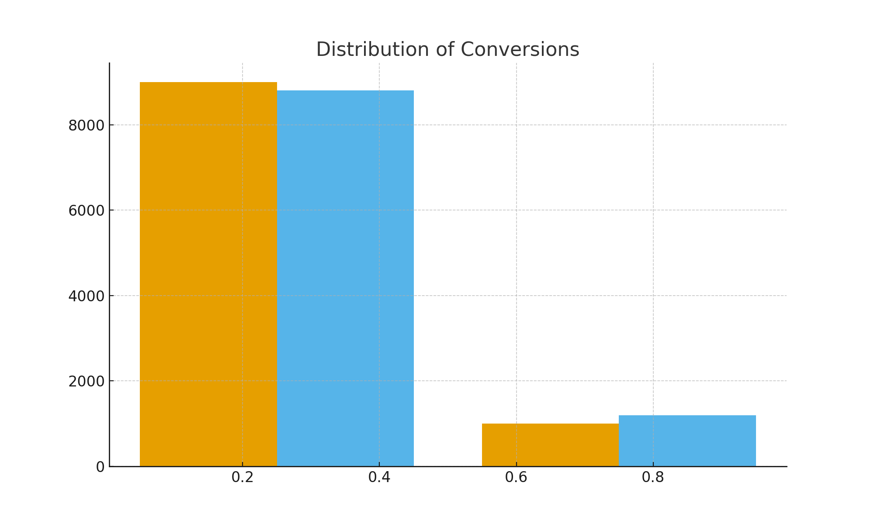
Распределение конверсий

Slide 35
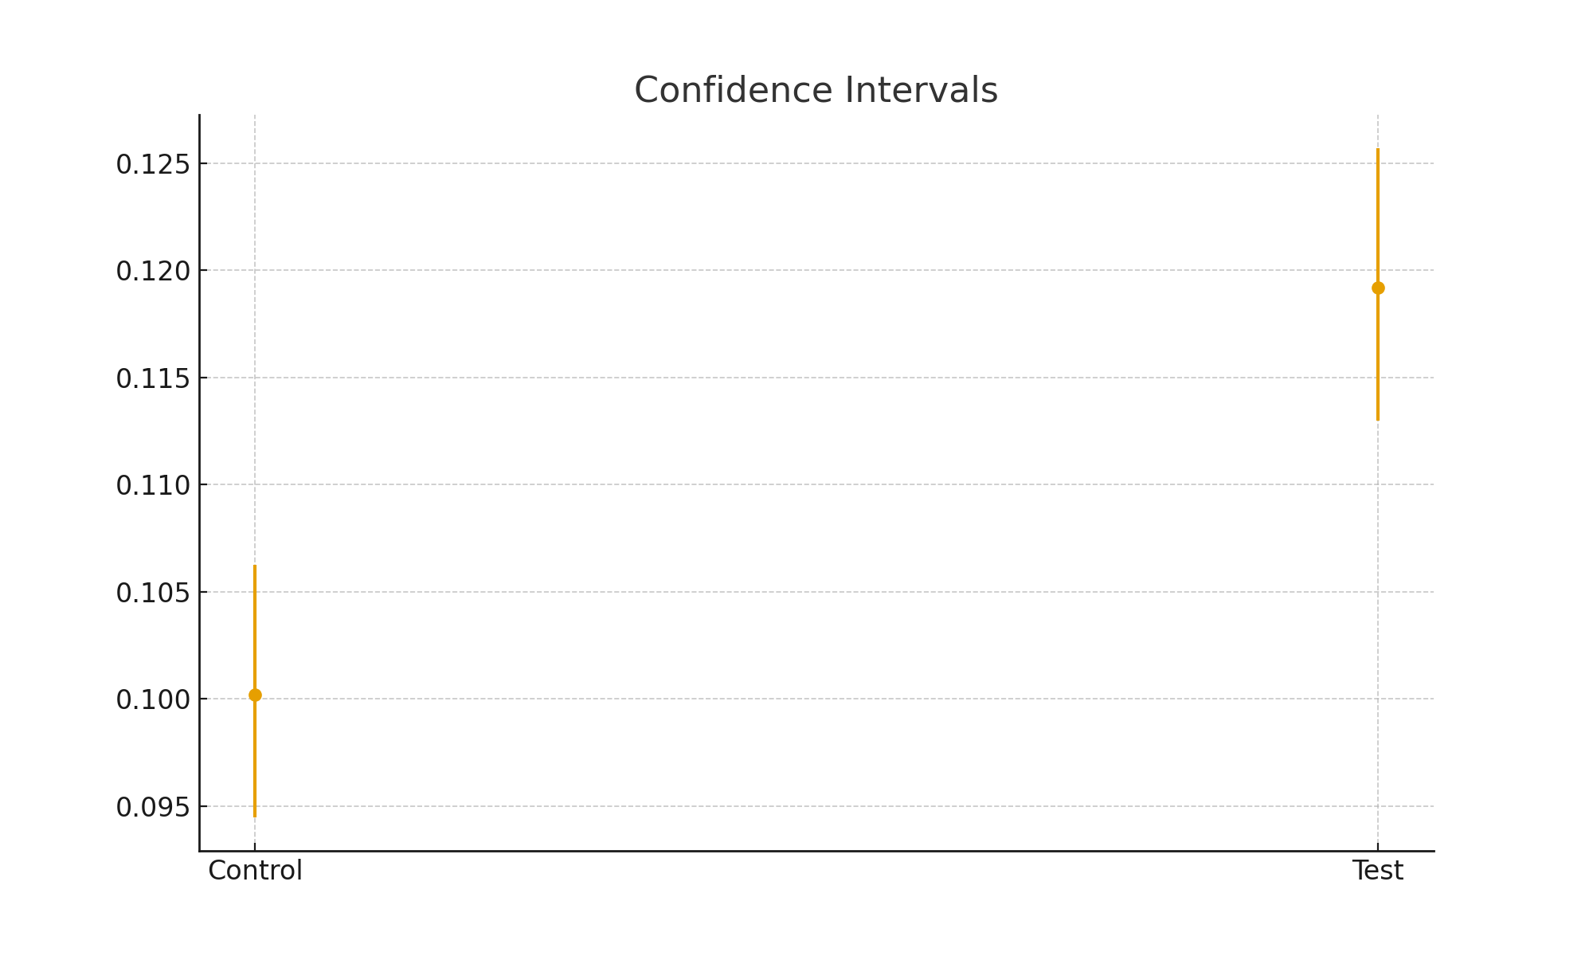
Доверительные интервалы

Slide 36
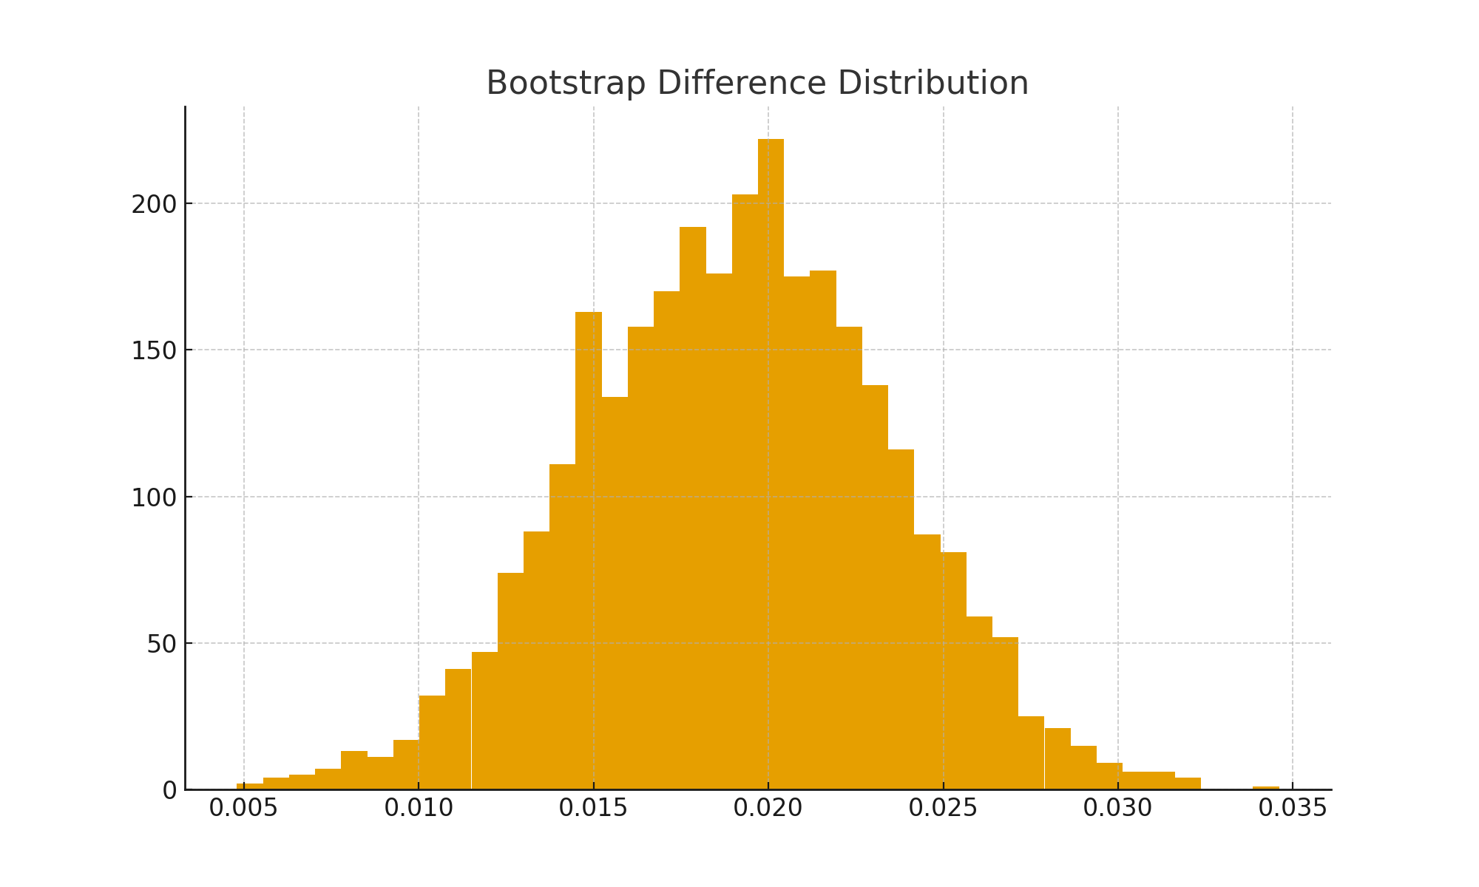
Bootstrap распределение разницы

Slide 37
Интерактивный кейс: тест баннера
A: “Купить сейчас”
B: “Получить скидку”
Сгенерировать данные
Посчитать CR
Построить CI
Провести bootstrap
Принять решение

Slide 38
📊 Did scientific research ⬄ now barely understand my own work
✈ Graduated from an Aviation university, studied aircraft systems ⬄
first passenger flight happened years later

Slide 39
Confidence Intervals
(Graph with error bars)
Python:
from statsmodels.stats.proportion import proportion_confint
(The rest of the code is the same as in the previous example.)

